Slide 1
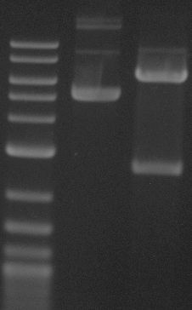
This gel depicts the NEB 1kb ladder and a digestion of the plasmid
24307 with the following enzymes: PstI
Plasmid 24307
7TFC
1kb Ladder
Uncut
PstI
1.0 1.2 1.5 2 3 4 5 6 8 10
DNA digested with PstI single digest for 2 hours
Gel: 0.8% TAE stained with 100 ml 1X TAE and 5uL of ethidium bromide
Ran for 2.5 hours at 47 volts

