Slide 1
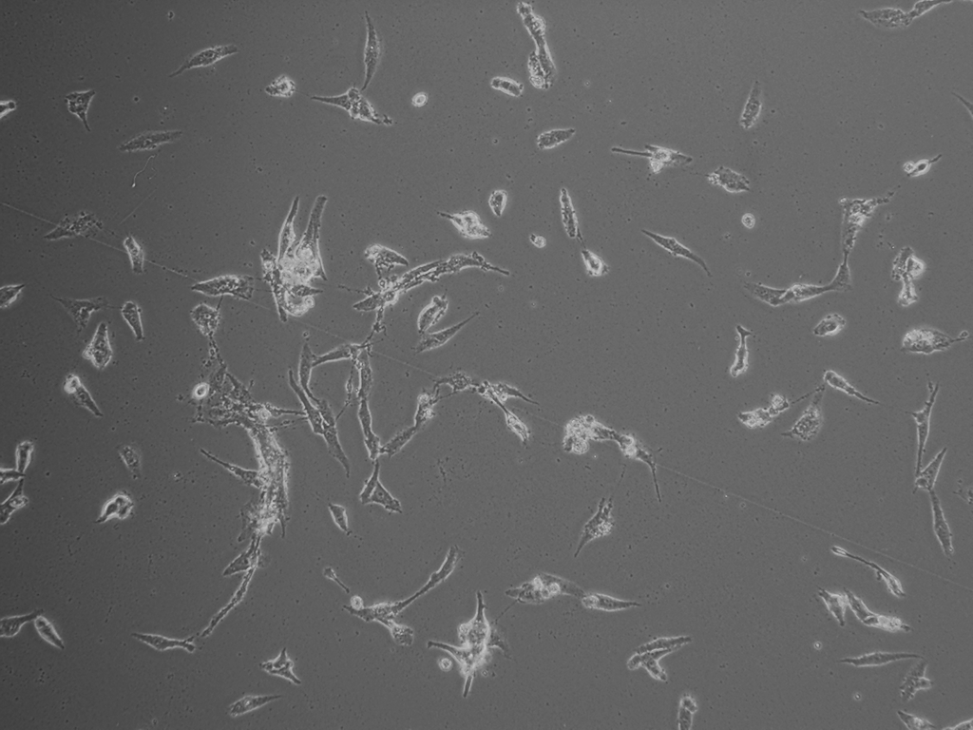
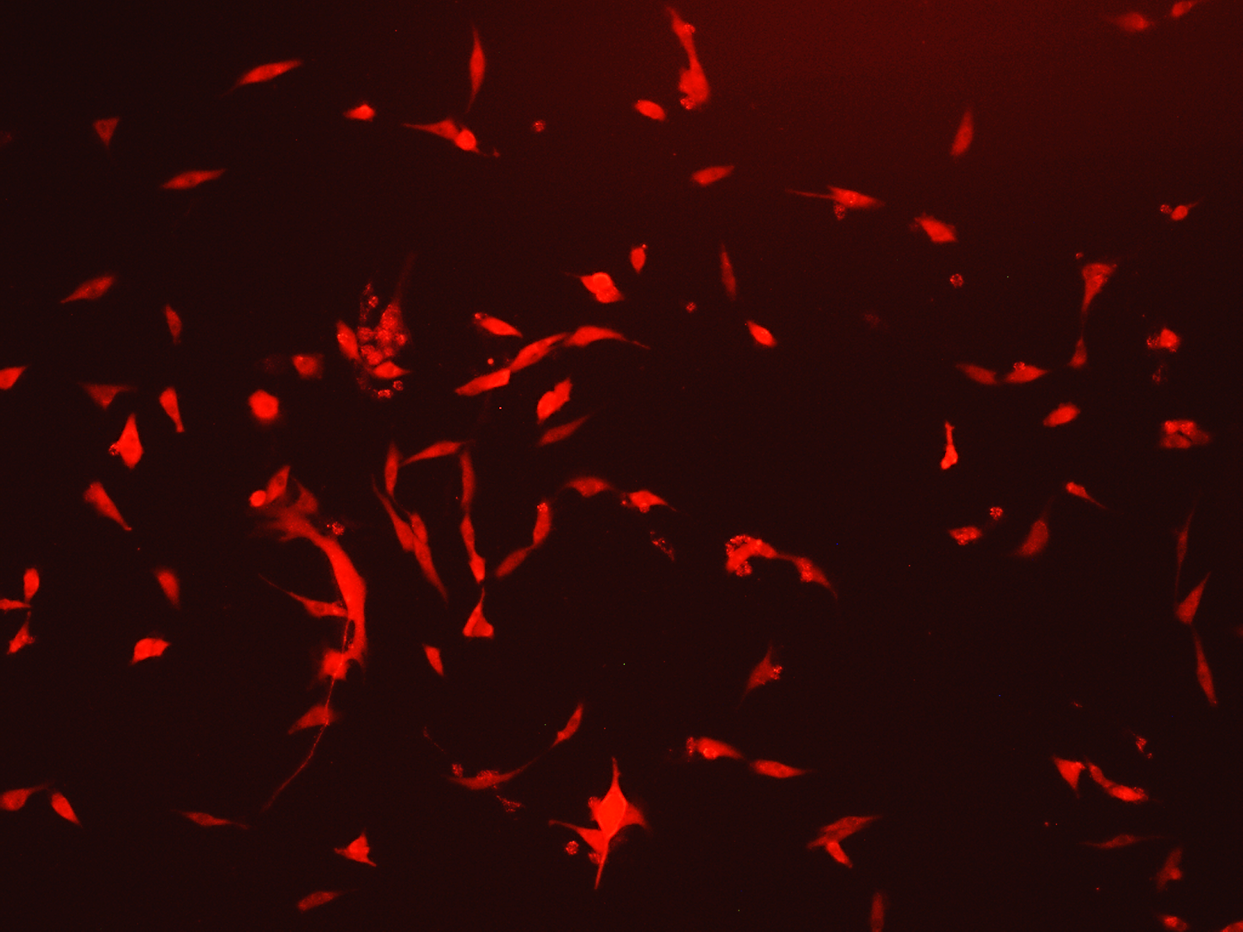
x100
x100
pLXIN2-RFP transduced U-87MG glioma, phase contrast microscopy
pLXIN2-RFP transduced U-87MG glioma, fluorescence microscopy

